Slide 1

Q3 Product Review
Cloud · Product team · July 2026

Slide 2
Agenda
• Highlights from the quarter
• Usage and growth
• What shipped
• Q4 roadmap
• Asks for leadership
Q3 Product Review · Cloud
2

Slide 3
Highlights
Files stored
Storage used
Share links
Active users
184k
2.7 TB
1,092
318
+12% QoQ
+0.4 TB
+31% QoQ
+9% QoQ
Share links grew fastest after PIN-protected links shipped in June. Storage growth is driven by video uploads from three design teams.
Q3 Product Review · Cloud
3

Slide 4
Uploads per month (thousands)
Q3 Product Review · Cloud
4

Slide 5
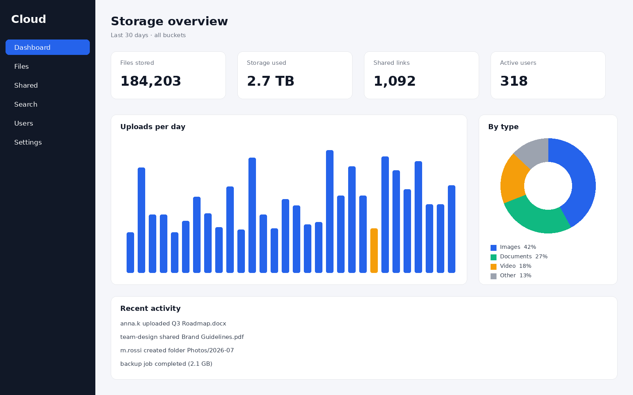
New admin overview
Storage, users and activity on one screen.
Replaces three separate admin pages.
Rolled out to all workspaces on 8 July.
Q3 Product Review · Cloud
5

Slide 6
Q4 roadmap
Theme | Milestone | Owner | Status
Sharing | Group sharing | Anna Kowalski | Planned
Search | Content search GA | Marco Rossi | In progress
Platform | Desktop sync client beta | Tom Schmidt | Proposed
Storage | Tiered object storage | Marco Rossi | Planned
Q3 Product Review · Cloud
6

Slide 7
Asks
• Approve two more search engineers for Q4
• Decide on desktop sync client scope by September
• Budget for the Limassol office fit-out
Q3 Product Review · Cloud
7

Slide 8
Questions?
product@files.example.com

